Slide 1
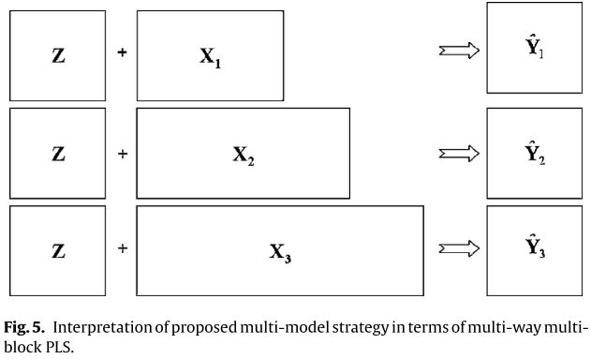
decision points
k1
k2
k3
Initial conditions
online measurements
Quality prediction

Slide 2
Simulation
Simulation
Simulation

